Slide 1
S E X U A L & G E N D E R M I N O R I T I E S
W H A T I S T H E P O I N T I N T I M E C O U N T ?
An annual street and shelter count that determines the number of people experiencing homelessness on O‘ahu on a single night in January (O'ahu's 2022 Count was delayed until March due to COVID-19).
Every Continuum of Care in the U.S. is required to submit PIT Count results to the U.S. Department of Housing and Urban Development (HUD) as part of a national effort to identify the extent of homelessness across the country.
I M P O R T A N T C O N S I D E R A T I O N S
The PIT Count is a one-night snapshot of homelessness
There are more people who experience homelessness over the course of the year than on any given single night.
W H A T I S T H I S R E P O R T L O O K I N G A T ?
This report looks at individuals who reported a gender identity different from the sex they were assigned at birth, a gender identity other than man/woman, indicated a sexual orientation other than straight, or indicated they were intersex during the 2022 O‘ahu Point in Time (PIT) Count.
Notes:
The O‘ahu Point In Time (PIT) Count is an annual street and shelter count that determines the number of people experiencing homelessness on O‘ahu on a single night in January (O'ahu's 2022 Count was delayed until March due to COVID-19). This project included a brief survey to identify the needs and characteristics of individuals and families experiencing homelessness. Every Continuum of Care in the U.S. is required to submit PIT Count results to the U.S. Department of Housing and Urban Development (HUD) as part of a national effort to identify the extent of homelessness across the country.
The PIT Count is a one-night snapshot of homelessness that is limited by weather conditions, number of volunteers and their training, self-reported survey responses, and other factors. There are more people who experience homelessness over the course of the year than on any given single night. Every year, the Continuum of Care works toward improving the Count’s accuracy. The O‘ahu Continuum of Care is committed to using data from the PIT Count and the O‘ahu Homeless Management Information System (HMIS) to understand more about the population experiencing homelessness on O'ahu and to provide solutions that will make homelessness rare, brief, and a one-time experience.

Slide 2
S E X U A L & G E N D E R M I N O R I T I E S
W H A T I S S G M ?
Sexual & Gender Minorities (SGM): An umbrella term that encompasses populations included in the (lesbian, gay, bisexual, transgender & intersex) and individuals whose sexual orientation or gender identity varies.
acronym
"LGBTI"
W H A T I S T H E M E T H O D O L O G Y U S E D ?
Four questions are asked to determine if an individual falls under the definition of SGM. These questions are only asked of individuals who are 18 years old or older.
"What is your sex assigned at birth?"
Single answer options: Male, Female, Unknown, Refused
"What is your current gender identity?" (asked of everyone regardless of age)
Multiple-choice answer options: Man/Boy, Woman/Girl, Transgender, A Gender that is not singularly "Female"/Gender Non-Conforming, Other Gender, Unknown, Refused
"Do you identify as intersex?"
Single answer options: Yes, No, Unknown, Refused
"Do you think of yourself as:"
Single answer options: Straight, Gay, Lesbian, Bisexual, Other Sexuality, Questioning/Unsure, Unknown, Refused
"Male" or
W H Y I S T H I S I M P O R T A N T ?
Little data is about how homelessness effects SGM adults and what percentage of homeless adults are SGM in Hawai‘i or nationally.

Slide 3
S G M : P O P U L A T I O N D I S T R I B U T I O N
183
individuals experiencing homelessness identified as Sexual & Gender Minorities on O‘ahu on the night of March 9, 2022
64%
Unsheltered
118 individuals were staying on the streets or other place not meant for human habitation
36%
Sheltered
65 individuals were staying in Emergency Shelter (36) or
Transitional Housing (30)
Emergency Shelter: Short-term
accommodations providing shelter to individuals and families. Transitional Housing: Mid-term accommodations,
designed to provide housing and supportive services to clients to
facilitate movement to independent living.
Notes:
The majority of the SGM PIT Count population was unsheltered. This is similar to the overall trend for the PIT Count population where 60% were unsheltered and 40% were sheltered.

Slide 4
S G M : P O P U L A T I O N C H A N G E O V E R T I M E , 2 0 2 0 - 2 0 2 2
Unsheltered surveyed SGM individuals account for 12% of the Unsheltered surveyed PIT Count population and Sheltered SGM individuals account for 4% of the shelter population.
Legend Total Unsheltered Surveyed Unsheltered Observed Sheltered
250
218
TOTAL
200
183
150
SURVEY
(Unsheltered)
103
107
100
OBSERVED
(Unsheltered)
103
65
50
12
11
0
SHELTERED
25
2020 2021* 2022
Count was canceled due to COVID-19. Only the Sheltered Count was conducted as these numbers are pulled from the HMIS database and
* The 2021 Unsheltered PIT
do not require in-person contact.
Unsheltered Observed: An Observational Tool was included to capture individuals who refused to be surveyed, were sleeping, or were inaccessible due to safety reasons. The Observational Tool is based on HUD's Observational Tool that captures minimal but highly important demographic information such as perceived age, race, ethnicity (Hispanic), and gender. We always advocate for individuals to be able to self-identify their own demographic information (especially their own gender identity) whenever possible. HMIS: The O‘ahu Homeless Management Information System (HMIS) is a countywide software program that is designed to capture client-level information over time on services used.
Notes:
While the overall number decreased, 2022 has data that is more reflective of the true population.
Unsheltered surveys did not significantly increase. This may be due to the fact that only 38% of the unsheltered population complete a survey; the majority of the unsheltered population was observed.
This is the second year that these questions were asked from the unsheltered population and the first time these questions were systematically asked of our sheltered population.
While there has been an overall decrease in the SGM population from 2020 to 2022, this is actually due in part to better understanding of SGM questions by the volunteers. In 2020, many individuals were Observed as "Other Gender" if the surveyor could not determine a gender; in 2022 surveyors were more likely to mark "Unknown" if gender could not be determined.

Slide 5
S G M : G E N D E R
For the purposes of analyzing demographics and characteristics, the remainder of this report will exclude the 11 observations. The following information will look at the remaining 172 SGM individuals.
3%
Gender Non-
<1%
Other Gender (1)
Conforming (6)
All individuals regardless of age are asked their current gender identity.
33%
Man/Boy (60)
Percent of Transgender & GNC Individuals
0.8% of the entire U.S. 2020 PIT Count Population². 0.7% of the population of Hawai‘i¹.
8%
Transgender (14)
43%
Woman/Girl (79)
7%
Multiple Gender Identities (12)
Transgender: A general term used to describe a person whose gender identity differs from the sex they were assigned at birth. Gender Non-Conforming (GNC):
Refers to a person who do not adhere to traditional gender roles or stereotypes about how they should look or act based on the sex they were assigned at birth.
Notes:
Women/Girls (43%) account for the largest percentage of SGM individuals, followed by Men/Boys, (33%).
50 individuals (29%) identified as gender diverse, meaning the individual identifies as a gender other than the sex they were assigned at birth. Within the surveyed PIT Count population (2,475) they account for 2%.

Slide 6
S G M : O R I E N T A T I O N
Only individuals over the age of 18 are asked their sexual orientation (171).
22%
Bisexual (37)
27%
Gay (46)
5%
Unknown (10)
25%
Straight (42)
9%
Lesbian (15)
11%
Other Sexuality (19)
1%
Questioning/ Unsure (2)
In Hawai‘i 4.6% of adults identify as SGM³. In the U.S. 3.5% of adults identify as SGM⁴.
Notes:
119 (70%) of SGM adults identified as an orientation other than straight. They account for 6% of the surveyed adult PIT Count population (1,965). Little data has been collected on SGM adults experiencing homelessness across the U.S. or in Hawai‘i. 2021 was the first year sexual orientation was required for all adults and heads of household across all O‘ahu HMIS program intake forms.

Slide 7
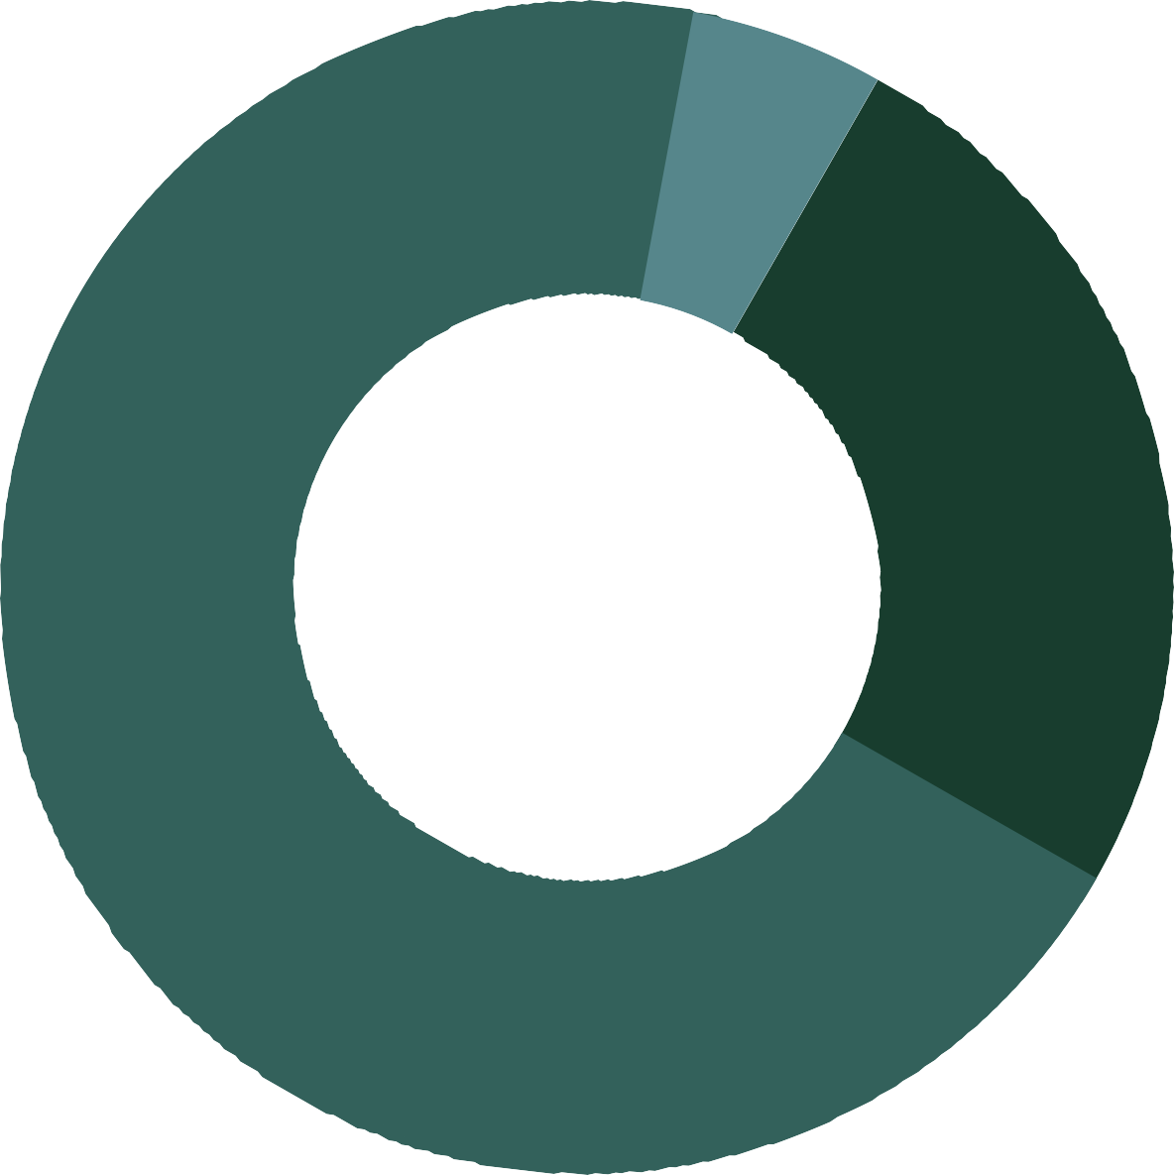
S G M : I N T E R S E X
Only individuals over the age of 18 are asked they identify as intersex (171).
7%
Unknown (12)
25%
Intersex (42)
68%
Not Intersex (117)
an estimated 1 in 2,000 babies is born intersex⁵.
Intersex: An umbrella term used to describe a person with a range of natural bodily variations in reproductive, genetic and /or sexual anatomy that does not fit the typical definitions of female or male.
Notes:
42 (25%) adults identified as intersex. They account for 2% of the surveyed adult PIT Count population (1,965). 14 (33%) individuals identified as being an orientation other than straight, and nine (21%) identified as gender diverse. Little data has been collected on intersex individuals, within the SGM or homeless community. 2021 was the first year intersex status was required for all adults and heads of household across all O‘ahu HMIS program intake forms.

Slide 8
S G M : A G E
SGM (172) V. SURVEYED PIT COUNT POPULATION (2,475)
Average Adult Age SGM PIT Count: 42
Hawai‘i SGM: 46³
Hawai‘i Non-SGM: 48³
Legend
SGM PIT Count Population Surveyed PIT Count Population
26%
23% _{15% 16%} 17% 17% _{15%} 9% _{8%} 5% 1% |  |  |  |  |  |  |  |  |  |  |  |  | 3% | 3%
(1) (510) | (16) | (132) | (44) | (366) | (40) | (391) | (29) | (431) | (22) | (363) | (14) | (276) | (6) | (70)
20%
13%
11%
Keiki
18-24
25-34
35-44
44-54
55-61
Kupuna
Unknown
Adult: Persons 18 years and older. Keiki: Persons under 18 years old. Kupuna: Persons 62 years and older.
Notes:
As compared to the surveyed PIT Count population, SGM adults are slightly younger, accounting for a higher percentage of youth (aged 18-24) and nearly half of the population between the ages of 25-44.

Slide 9
S G M : H O U S E H O L D S T R U C T U R E
INDIVIDUALS BY HOUSEHOLD TYPE
Number of SGM individuals (Total individuals in Household) / Number of Households
75%
128 Individuals Single Adults (25+)*
21 SGM Individuals (39 total indvs) / 14 Households
12% Adult Only Households
8 SGM Individuals (35 total indvs) / 8 Households
5% Adult(s) with Keiki
1 SGM Individuals (2 total indvs)/ 1 Households
Parenting Youth
In the U,S.
61% of SGM | individuals | have a partner⁷
10% of SGM | individuals | have keiki⁷
14 Individuals / 14 Households
8% Unaccompanied Youth
Household: Any group of individuals that presents together for assistance and self-identifies as a family/household. Single Adults: Person living alone who is 25
years old or older. Adult Only Households: Two or more adults living together with no one under the age of 18. Adult(s) with Keiki: One or more adults living with one or more keiki under the age of 18. Parenting Youth (PY): Persons age 24 and under living with one or more keiki under the age of 18. Unaccompanied Youth
(UY): Persons age 24 and under who are not accompanied by a parent, guardian, or household member 25 or older and are not a parent. UY can include single youth, youth couples, and groups of youth together as a household.
Notes:
Single individuals account for the largest household type of SGM households at 83%. This is higher than the surveyed PIT Count population (54%) and the U.S. adult SGM population (39%)⁷. Very few SGM individuals (<6%) reported living with
keiki as compared to the surveyed PIT Count population(35%), U.S. adult SGM population (10%)⁷, and the Hawai‘i SGM population (30%)³.

Slide 10
S G M : R A C E / E T H N I C I T Y
RACE/ETHNICITY
Race/Ethnicity Alone (mutually exclusive categories)
Legend SGM PIT Count Population Population of O‘ahu⁶
43%
31%
33%
22%
23%
17%
9%
10%
2%
4%
3%
3%
<1%
1%
American Indian, Alaska Native, or Indigenous
Asian or Asian American
Black, African American or African
Native Hawaiian or Pacific Islander
White
Multiple Races
Other
Unknown
American Indian, Alaska Native, or Indigenous (AIANI): Person having origins in any of the original peoples of North, South, and Central America, Cuba, or Puerto Rico. Native Hawaiian and Pacific Islander (NHPI): Person having origins in any of the original peoples of Hawai‘i, Guam, Samoa, Tonga, Micronesia, or other
Pacific Islands.
Notes:
Native Hawaiian or Pacific Islanders, Multi-Racial, and Black individuals are over-represented within the SGM PIT Count population as compared to the population of O‘ahu by 221%, 45% and 45%, respectively. While White and Asian or Asian American individuals are under-represented by -19% and -80%, respectively.

Slide 11
S G M : R A C E / E T H N I C I T Y
RACE/ETHNICITY
Race/Ethnicity Alone or in Combination (an individual may be
counted in multiple categories as part of Multi-Racial Identity)
Native Hawaiian or Pacific Islanders, Multi-Racial, and Black individuals are over-represented within the SGM PIT Count population as compared to the population of O‘ahu by 221%, 45% and 45%, respectively. While White and Asian or Asian American individuals are under-represented by -19% and -80%, respectively.
Native Hawaiian
White Filipino
Hispanic or Latin(a)(o)(x) Chinese/Taiwanese
Samoan Other Pacific Islander
Black Japanese Other Asian
AIANI
Micronesian
Race Unknown
Korean Other Asian
Vietnamese 2
NHPI Unknown 1
Tongan 1
80
56
32
30
24
17
12
10
10
9
8
6
47% of SGM individuals identify as Native Hawaiian
On O‘ahu 17.8% of the population identify as Native Hawaiian⁶
5
3
3
NHPI Unknown: Specific ethnicity within Native Hawaiian or Pacific Islander is not known.

Slide 12
S G M : H E A L T H
Health | SGM |  |  |  | Surveyed PIT Count
 | Unsheltered | Sheltered | Total
Chronically Homeless (Unsheltered and Emergency Shelter Only) | 55% (59) | 30% (19) | 46% (78) |  | 37% (723)
Physical, Developmental, or Other Disability | 31% (33) | 52% (33) | 39% (66) |  | 38% (748)
Mental Health Illness | 45% (48) | 67% (43) | 53% (91) |  | 38% (739)
Substance Use Disorder | 36% (38) | 45% (29) | 39% (67) |  | 31% (609)
HIV/AIDS | 4% (4) | 13% (8) | 7% (12) |  | 2% (37)
3 or More Disabling Conditions | 12% (13) | 25% (16) | 17% (29) |  | 11% (218)
Experiencing Homelessness due to COVID-19 | 26% (28) | 13% (8) | 21% (36) |  | 15% (298)
In the U.S. 40% of SGM
adults reported
a
debilitating Condition⁷.
Health
In Hawai‘i an estimated 11.4% of the population has a disability⁸.
Chronically Homeless: A person who is homeless and lives in a place not meant for human habitation, a safe haven or in an emergency shelter AND has been homeless for at least 1 year continuously or on at least 4 or more occasions over the past 3 years that add up to at least 12 months AND has a disability. Disabling Condition is classified as a Serious Mental Health Illness, Disability, Substance Use Disorder or living with HIV/AIDS. Serious Mental Health Illness, Substance Use Disorder and Disability are classified as a condition(s) that substantially impairs a persons daily life.
Notes:
Sexual and Gender Minorities have higher rates of disabling conditions as compared to the overall homeless population.
32% of all individuals with HIV identify as SGM
46% are chronically homeless indicating that they have experienced homelessness for a long period of time while living with a disabling condition.
SGM individuals have a higher rate of mental health illness as compared to the adult surveyed PIT Count population

Slide 13
S G M : D O M E S T I C V I O L E N C E
39%
27% 17%
of of of
women men trans & gnc
have experienced Domestic Violence
Domestic Violence (DV): describes physical violence, sexual violence, stalking, and/or psychological harm by a current or former partner, spouse, or family member.
Notes:
Domestic Violence is significantly higher among the SGM PIT Count population as compared to the O‘ahu PIT Count population.
30% of SGM adults reported having experienced DV as compared to 19% of the overall homeless population.
Domestic Violence also plays a larger role in why SGM individuals are currently experiencing homelessness as compared to overall homeless population.
13% of SGM adults reported currently fleeing DV, as compared to 5% of the overall homeless population.

Slide 14
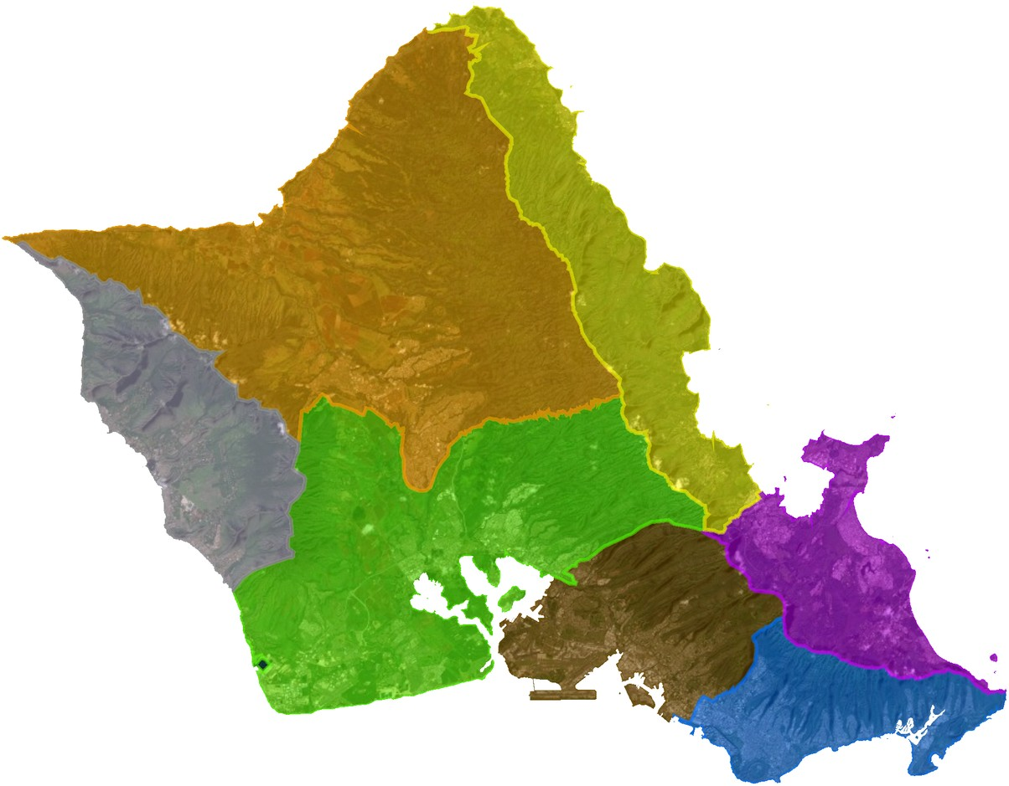
S G M : G E O G R A P H I C D I S T R I B U T I O N
PERCENT OF TOTAL SGM POPULATION BY REGION
This excludes any individuals from DV shelters but, includes observations (178)
1%
2 Unsheltered
1%
2 Unsheltered
Region 6
Region 5
Region 7
15%
24 Unsheltered
2 Sheltered
9%
12 Unsheltered
4 Sheltered
Region 3
Region 4
Region 1
17%
13 Unsheltered
18 Sheltered
36%
31 Unsheltered
33 Sheltered
Region 2
21%
34 Unsheltered
3 Sheltered
Notes:
Region 1 has the largest percentage of the SGM population, sheltered and unsheltered, this is due in part to this area having a high number of shelters. Region 2 and Region 7 have the first and third highest number of unsheltered SGM individuals.

Slide 15
S E X U A L & G E N D E R M I N O R I T I E S
REPEATERS (55)
The number of PIT Counts and individual has been counted in since 2017
Legend Consecutive Counts Episodic Counts
13
14
58% (33) individuals were counted in non- consecutive years (episodically) which may indicate that they have cycled in and out of homelessness.
9
8
5
5
1
5 PIT Counts
2 PIT Counts 3 PIT Counts
* The 2021 Unsheltered PIT
4 PIT Counts
Count was canceled due to COVID-19
therefore, any individual counted in 2020 and again in 2022 was considered consecutive.
Repeaters: Persons who have been counted in PIT Counts between 2017 and 2022. Consecutive Counts: An individual who was counted in two or more PIT Counts in consecutive years (i.e. 2017 and 2018 or 2019, 2020, and 2022). Episodic Counts: An individual who was counted in two or more PIT Counts in non-consecutive years (i.e. 2017 and 2020 or 2018, 2019 and 2022).
Notes:
32% (55 out of 172) of surveyed SGM individuals had been counted in a previous PIT Count, since 2017.
58% (33) individuals were counted in non-consecutive years (episodically) which may indicate that they have cycled in and out of homelessness.

Slide 16
S E X U A L & G E N D E R M I N O R I T I E S
This section examines characteristics of the 107 individuals in 100 households surveyed as unsheltered in the 2022 PIT Count.
SELF-REPORTED FACTORS LEADING TO HOMELESSNESS (107)
Surveyed individuals may choose multiple reasons for currently experiencing homelessness.
Substance Use (29)
27%
Unable to Pay Rent (25)
23%
45% of individuals reported multiple causes for currently experiencing homelessness. The leading causes across all individuals were substance use and financial issues.
Loss of Money (23)
21%
Job Loss (20)
19%
Mental Illness (16)
15%

Slide 17
S E X U A L & G E N D E R M I N O R I T I E S
This section examines characteristics of the 107 individuals in 100 households surveyed as unsheltered in the 2022 PIT Count.
38%
experienced homelessness before the age of 18
More than 1/3 of the SGM population has experienced homelessness before the age of 18, indicating a history of housing instability.
In the U.S.
17% of SGM adults have experienced homelessness⁹.
29% of SGM adults experienced homelessness before the age of 18⁹.
Notes:
How they experienced homelessness as a youth
22 people by themselves.
14 people with their family.
3 people by themselves & with their family.
2 people refused to specify.

Slide 18
S G M : W H A T N E X T ?
Gender diverse individuals make up a third of SGM individuals and are over-represented with in O‘ahu PIT Count population.
Sexual and Gender Minorities have higher rates of disabling conditions as compared to the overall PIT Count Population with mental illness and HIV/AIDS substantially higher than the general PIT Count population.
SGM individuals also have a lifetime history of domestic violence that is 1.5 times higher as compared to the overall PIT Count Population.
Unsheltered surveyed SGM individuals account for 12% of the unsheltered surveyed PIT Count population and sheltered SGM individuals account for 4% of the shelter population.
Further studies are needed to understand if there are barriers that SGM individuals are facing in accessing shelter.
Notes:
The distribution of SGM individuals in the unsheltered and shelter population mimics that of the overall PIT Count population.
There is little to no data on SGM adults experiencing homelessness; much of research on homelessness among SGM people focuses on youth. Similar to findings from the Williams Institute⁹, the data for this report shows that nearly a third of all SGM adults on Oʻahu experienced homelessness as youths, highlighting that SGM experiences with homelessness do not always begin or end at adulthood.

Slide 19
S G M : R E F E R E N C E S
Herman, J.L., Flores, A.R., O’Neill, K.K. (2022). How Many Adults and Youth Identify as Transgender in the United States? The Williams Institute, UCLA School of Law
National Alliance to End Homelessness, n.d. State of Homelessness: 2021 Edition. [online] National Alliance to End Homelessness.
Available at: <https://endhomelessness.org/homelessness-in-america/homelessness-statistics/state-of-homelessness-2021/> [Accessed 17 June 2022].
LGBT Demographic Data Interactive. (January 2019). Los Angeles, CA: The Williams Institute, UCLA School of Law.
Gates, G.J. (2011). How many people are lesbian, gay, bisexual, and transgender? The Williams Institute, UCLA School of Law
interACT: Advocates for Intersex Youth | Intersex-led law and policy, media, and youth leadership development. 2022. FAQ | interACT: Advocates for Intersex Youth. [online] Available at: <https://interactadvocates.org/faq/> [Accessed 17 June 2022].
United States Census Bureau. (n.d.). S0201 SELECTED POPULATION PROFILE IN THE UNITED STATES 2019: ACS 1-Year Estimates Selected Population Profiles. https://data.census.gov/cedscitable?q=United%20States&=062%20-
%20Native%20Hawaiian%20alone%20or%20in%20any%20combination&g=0400000US15_0500000US15003
Meyer, I.H., Wilson, B.D.M., & O’Neill, K. (2021). LGBTQ People in the US: Select Findings from the Generations and TransPop Studies.
Los Angeles: The Williams Institute.
United States Census Bureau. (n.d.). S1810 DISABILITY CHARACTERISTICS 2020: ACS 5-Year Estimates Subject Tables. https://data.census.gov/cedscitable?q=United%20States&=062%20-
%20Native%20Hawaiian%20alone%20or%20in%20any%20combination&g=0400000US15_0500000US15003
Wilson, B. D. M., Choi, S. K., Harper, G. W., Lightfoot, M., Russell, S., & Meyer, I.H. (2020). Homelessness among LGBT adults in the U.S. Los Angeles, CA: Williams Institute

